Slide 1
Welcome to Bienvenue au
McGill University

Slide 2
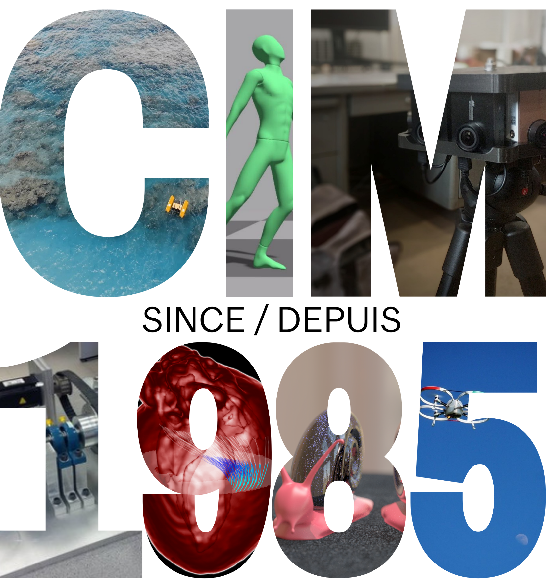

Slide 3
About CIM
A hub for robotics and intelligent systems, including artificial intelligence, computer vision, haptics, 3D graphics, systems and control
National and international collaborations
Cross-disciplinary community and legacy

Slide 4
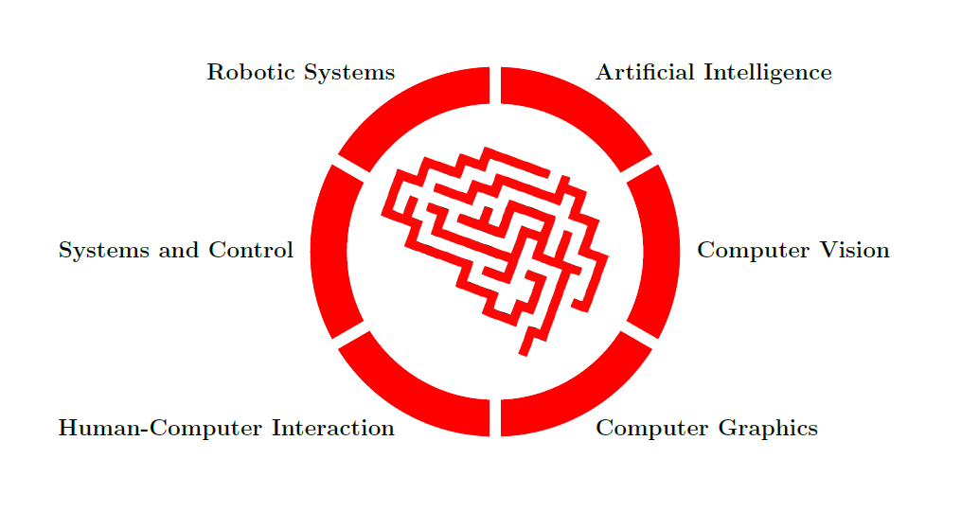
Six Core Research Themes

Slide 5
CIM in a Nutshell
Three departments across two faculties
School of Computer Science
Electrical and Computer Engineering
Mechanical Engineering
27 Full members and 16 Associate members
17 Research labs
200+ Peer-reviewed publications per year

Slide 6
Our Student Researchers
107 PhD researchers
105 Master's researchers
145 Undergraduate researchers
19 Post-doctoral fellows

Slide 7
Robotic Systems
Overview
Development of autonomous and guided robots for varied tasks, human interaction, and multi-modal navigation
Members
Jorge Angeles*, ME
Gregory Dudek, CS
James Forbes, ME
Jozsef Kovecses, ME
Hsiu-Chin Lin, ECE/CS
David Meger, CS
AJung Moon, ECE
Meyer Nahon, ME
Joelle Pineau, CS
Audrey Sedal, ME
Inna Sharf, ME

Slide 8
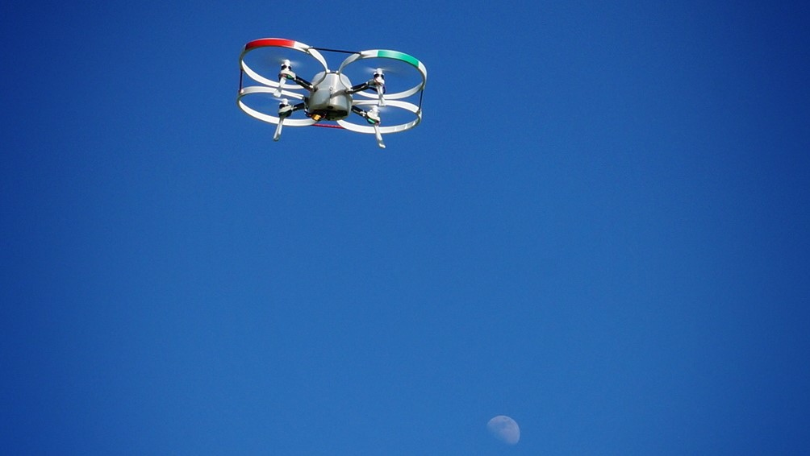
Aerospace Mechatronics
Inna Sharf & Meyer Nahon
Robotic Systems
The McGill Aerospace Mechatronics Laboratory is dedicated to supporting research themes revolving around aeronautical and space systems, more specifically, Unmanned Aerial Vehicles (UAVs) and Space Robotic systems.

Slide 9
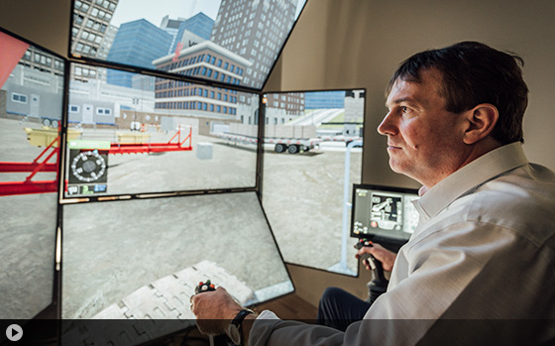
Applied Dynamics
Jozsef Kovecses
Robotic Systems
Our research group has a strong background and expertise in dynamics, robotics and haptics, solid mechanics, modelling and analysis, mechatronics and control, computational methods, and algorithms.

Slide 10
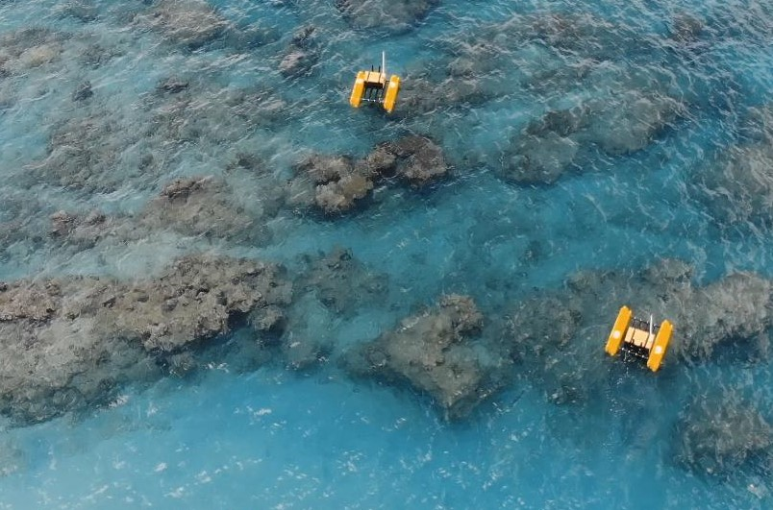
Mobile Robotics
Gregory Dudek, Dave Meger & Hsiu-Chin Lin
Robotic Systems
The key theme of our lab's research is sensor-based robotics, namely the use and understanding of sensor data through computer vision and machine learning, as well as decision-making under uncertainty.

Slide 11
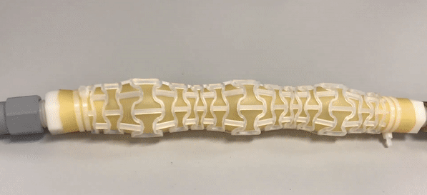
MACRObotics
Audrey Sedal
Robotic Systems
Our research blends mechanical design, continuum mechanics, and machine learning to create robots that behave safely and with morphological intelligence.

Slide 12
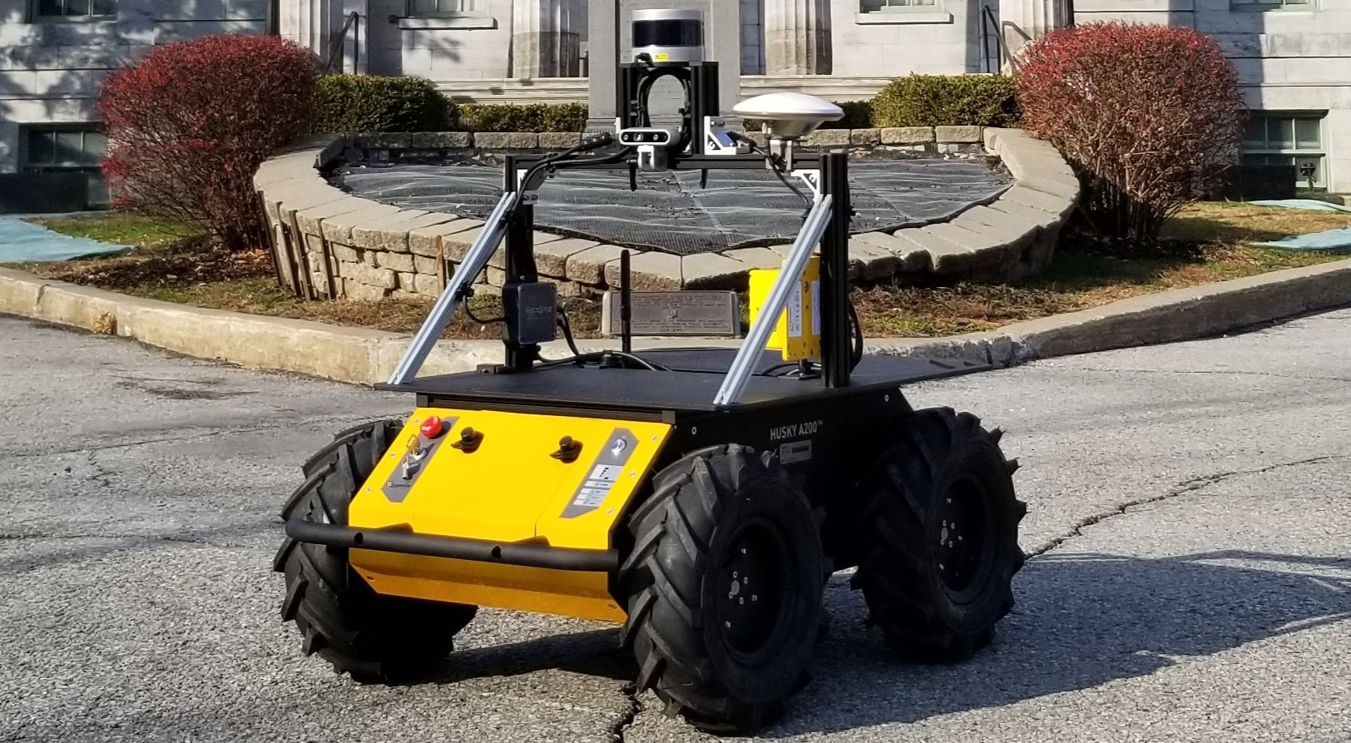
DECAR
James Richard Forbes
Robotic Systems
DECAR conducts fundamental and applied research on state estimation (navigation), guidance, and control. Problems in air, ground, marine, space, and manipulator robotics are of particular interest to the group.

Slide 13
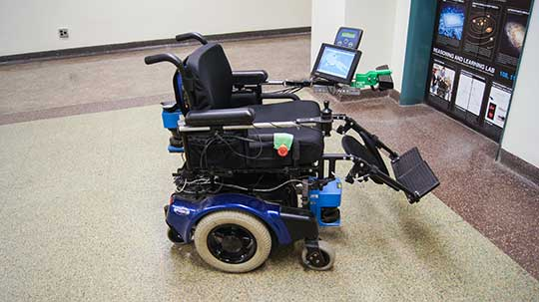
Reasoning and Learning
Joelle Pineau
Robotic Systems
Current areas of interest include Markov processes, deep learning and its applications, reinforcement learning, natural language processing and computational linguistics.

Slide 14
Human-Computer Interaction
Overview
The technological development and ethical study of novel interaction paradigms, connecting humans with a diversity of sensory interfaces
Members
Jeremy Cooperstock, ECE
Jozsef Kovecses, ME
AJung Moon, ECE

Slide 15
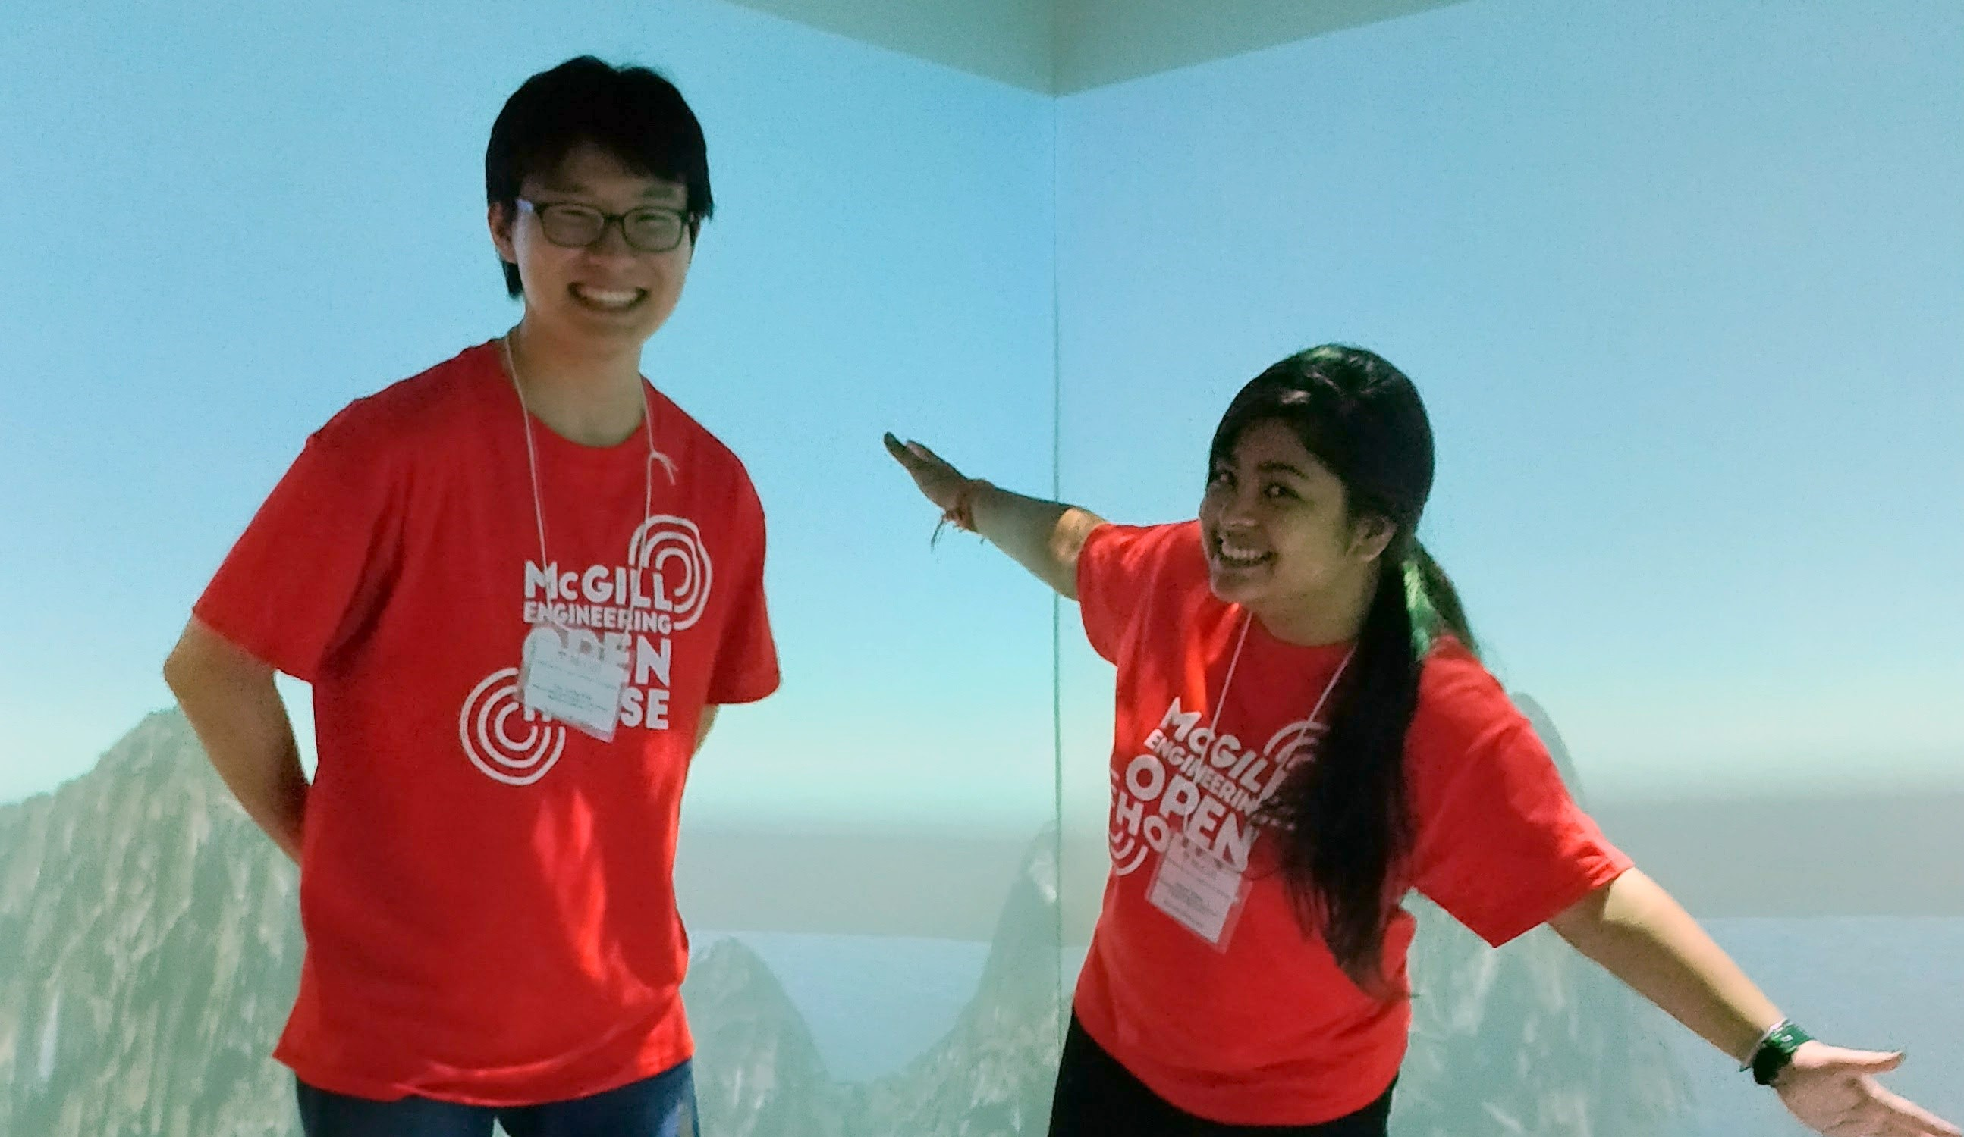
Shared Reality Lab
Jeremy Cooperstock
Human-Computer Interaction
The goal of Shared Reality is to achieve high-fidelity distributed interaction, with both real and virtual data, at levels of presence that support the most demanding applications, and to do so in spite of sensor and bandwidth limitations.

Slide 16
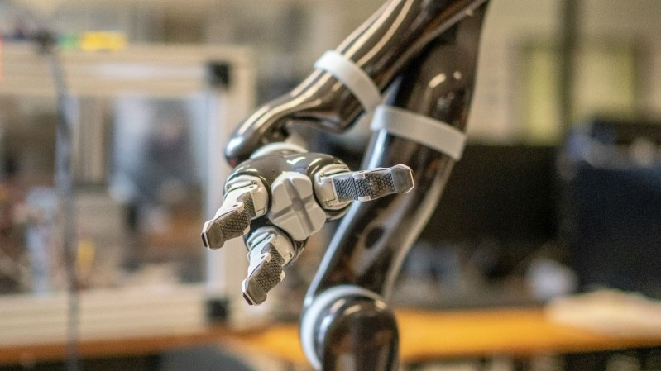
RAISE Lab
Ajung Moon
Human-Computer Interaction
The RAISE lab is an interdisciplinary group that investigates the social and ethical implications of robots and AI systems and explores what it means for engineers to be designing and deploying such systems responsibly for a better, technological future.

Slide 17
Computer Graphics
Overview
The development of mathematical models of real world dynamics, and numerical methods for synthesizing these visual phenomena for, e.g., games and visual effects
Members
Derek Nowrouzezahrai, ECE
Paul Kry, CS

Slide 18
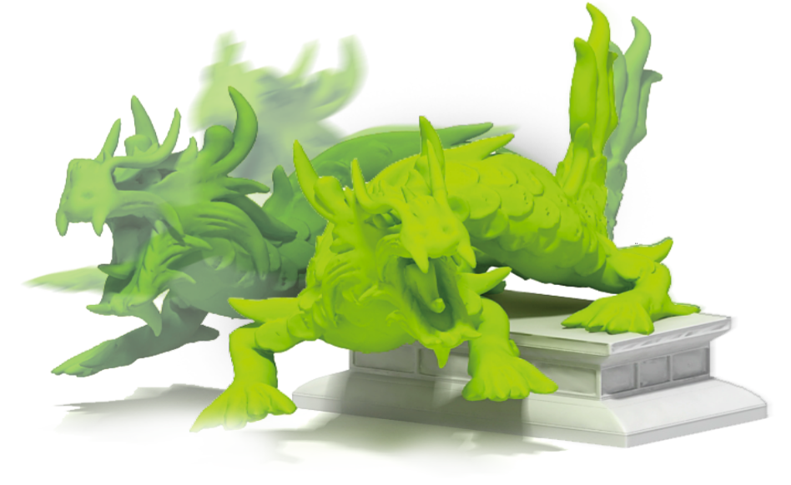
Computer Animation
Paul Kry
Computer Graphics
The computer graphics lab at McGill is concerned with problems in physically based animation, skin deformations of articulated characters, motion capture, interaction, and physically based modeling of humans and animals.

Slide 19
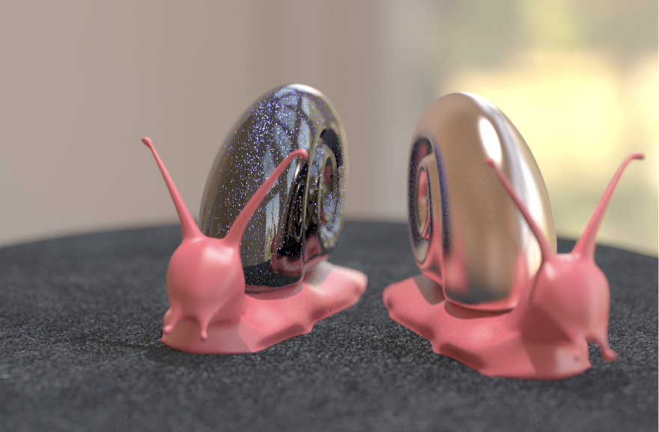
Graphics
Derek Nowrouzezahrai
Computer Graphics
We work on animation and rendering algorithms for video games and VR, physics-based models for visual effects in films, and applied machine learning

Slide 20
Computer Vision and Medical Image Analysis
Overview
Development of automatic methods for understanding the structure of the real world from imaging sensors, e.g., in photographic and medical contexts
Members
Tal Arbel, ECE
James Clark, ECE
Frank Ferrie*, ECE
Michael Langer, CS
Martin Levine*, ECE
Kaleem Siddiqi, CS

Slide 21
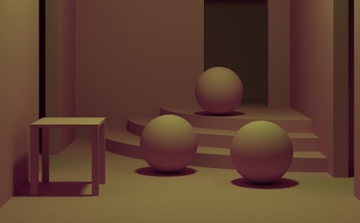
Appearance Modeling
Michael langer
Computer Vision
Research topics include applied perception in graphics, human vision and appearance models.

Slide 22
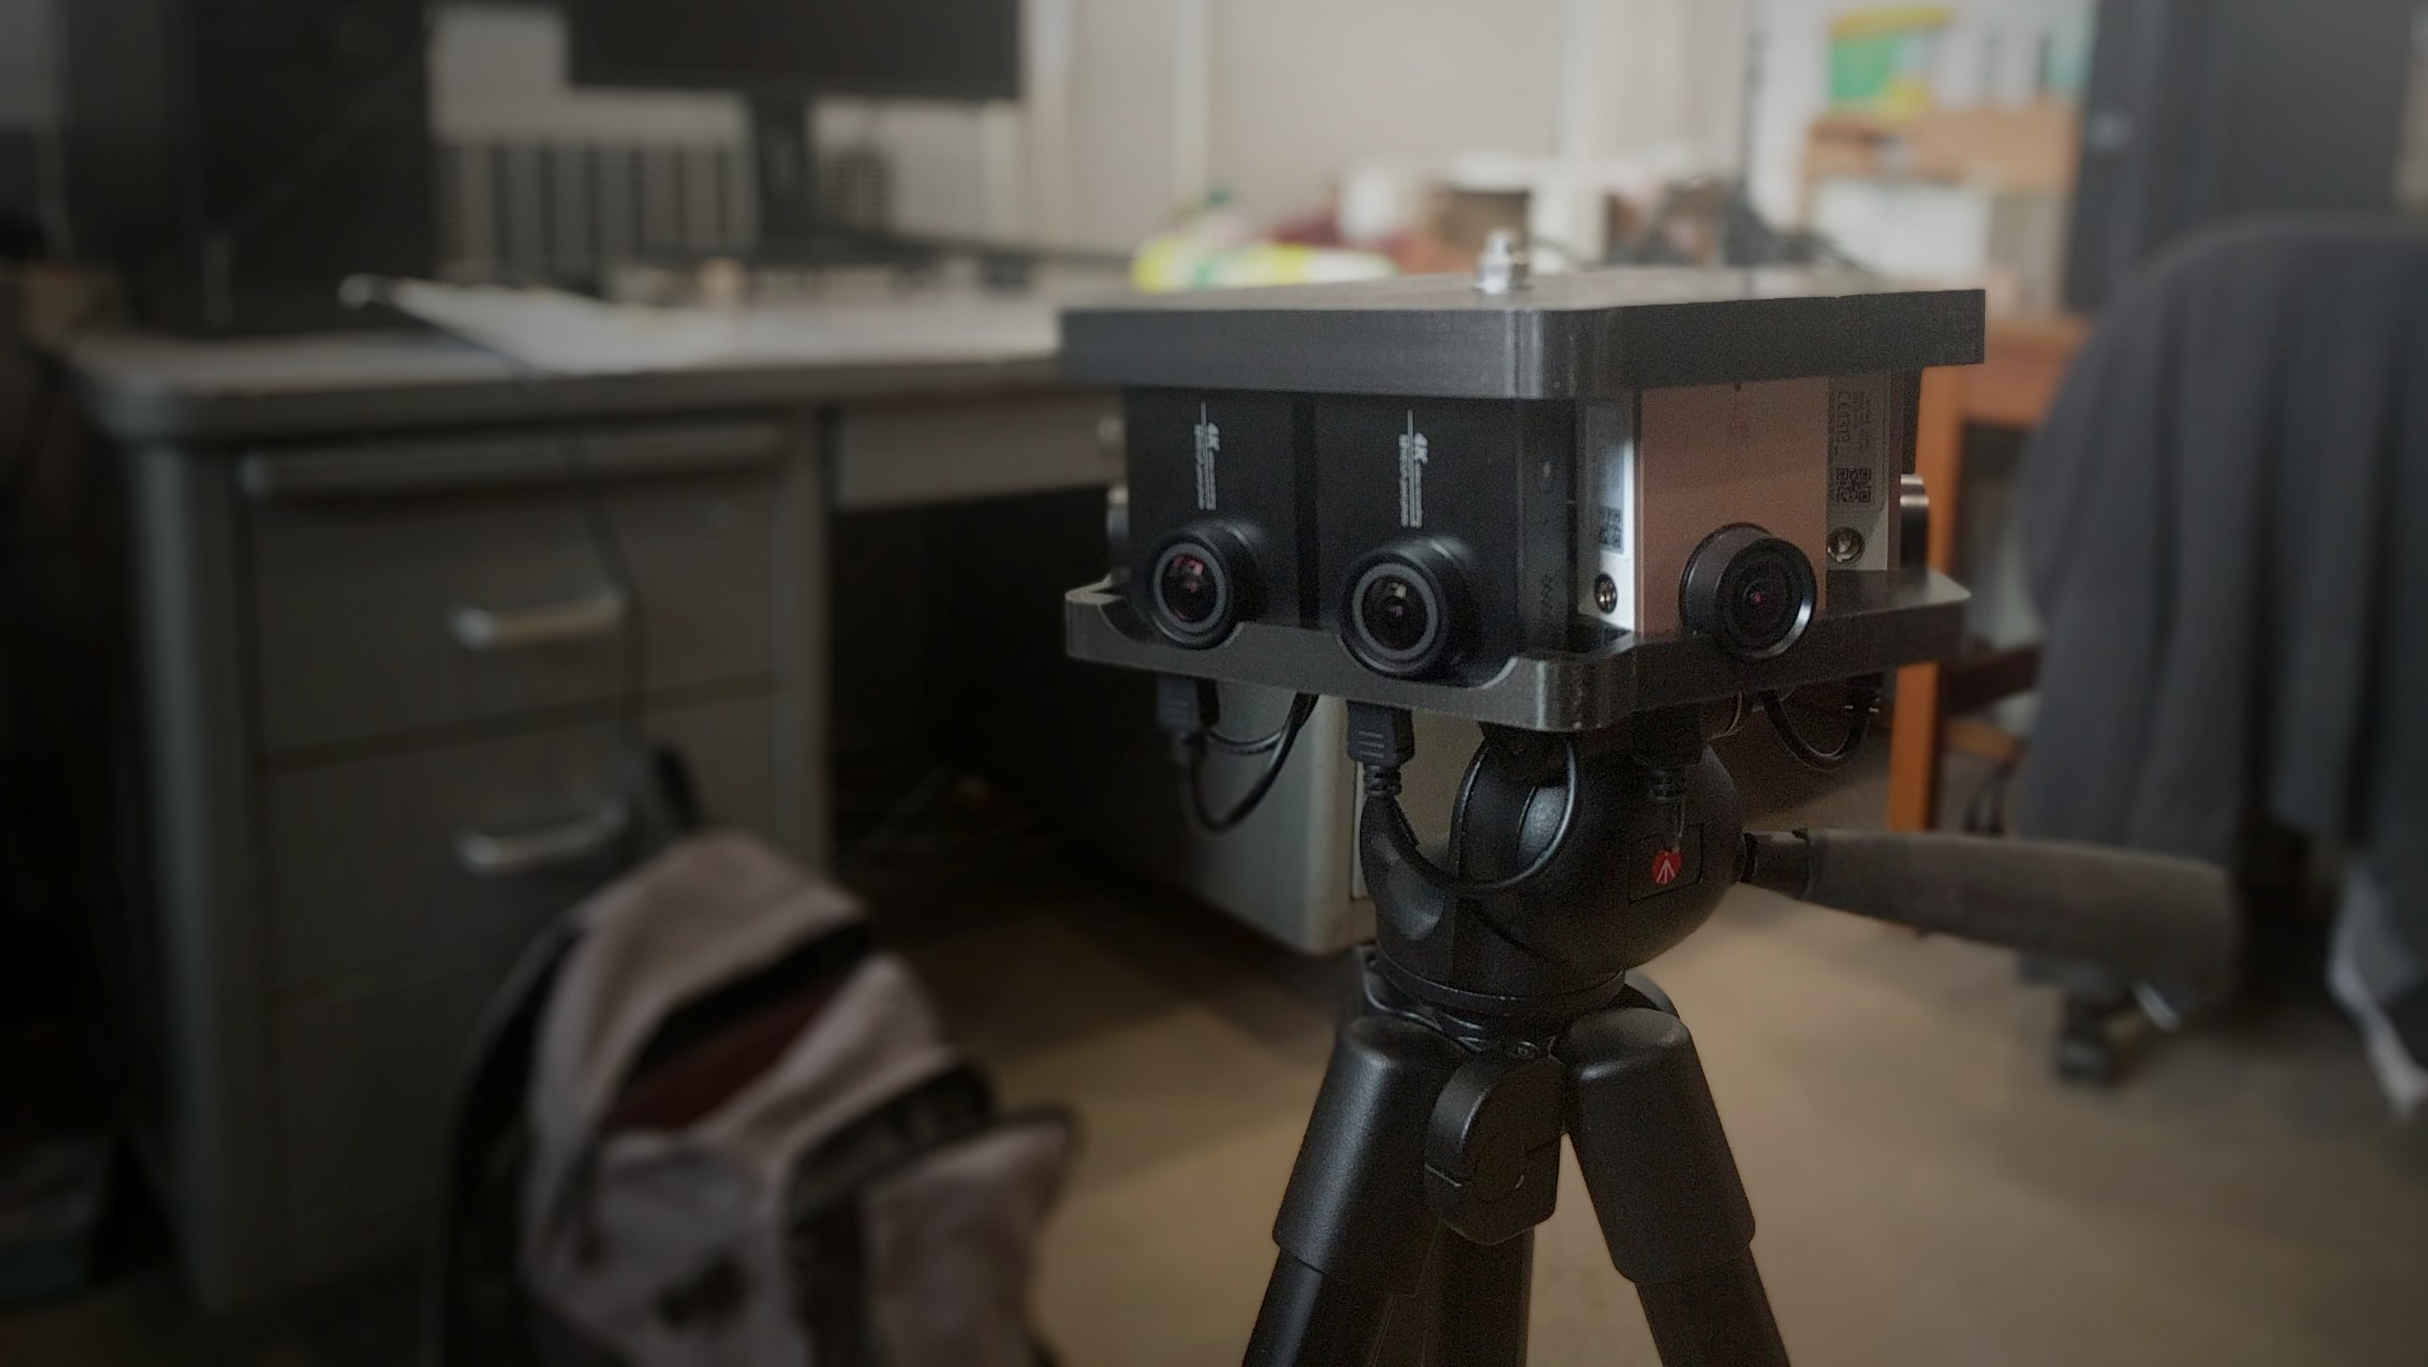
Visual Motor Research
James Clark
Computer Vision
Current research interests include Attention Modeling and Tracking, Generation and Analysis of Cinematic Imagery, Spectral Modeling and Colour Vision, and Augmented Reality and Video Surveillance.

Slide 23
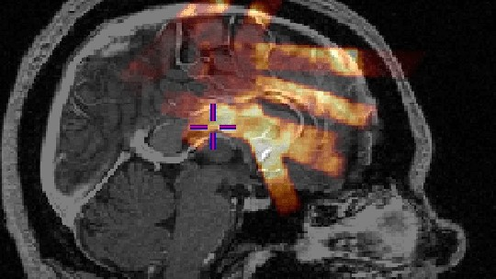
Probabilistic Vision
Tal Arbel
Medical Image Analysis
The focus of our research is on developing probabilistic machine learning and modern deep learning models for medical image analysis.

Slide 24
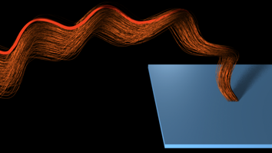
Shape Analysis
Kaleem siddiqi
Medical Image Analysis
Drawing on techniques from singularity theory, partial differential equations, geometric flows and graph theory, our group is broadly concerned with the problem of shape analysis in computational vision and medical imaging.

Slide 25
Systems & Control
Overview
Studying real world systems to create predicative models and controls with applications in medical equipment and electric vehicles
Members
Benoit Boulet, ECE​
Peter Caines, ECE​
Warren Gross, ECE​
Aditya Mahajan, ECE​
Arun Misra, ME​
Meyer Nahon, ME

Slide 26
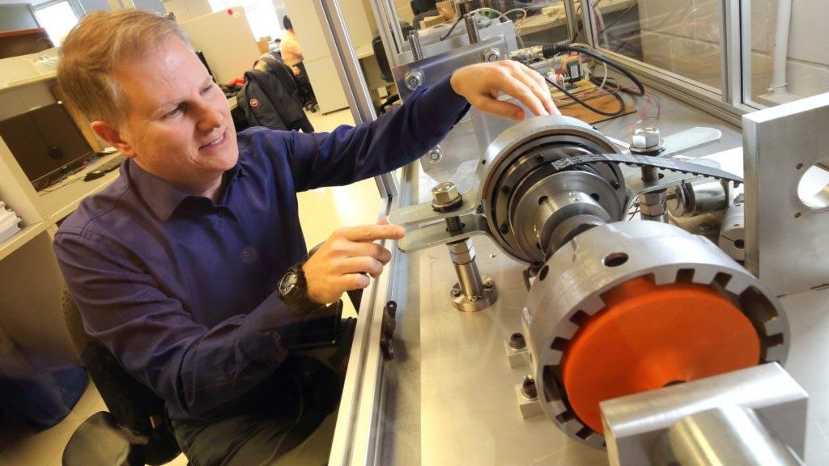
Intelligent Automation
Benoit Boulet
Systems & Control
The Intelligent Automation Lab focuses on research and development of automation and machine learning solutions to enable novel environmentally sustainable systems.

Slide 27
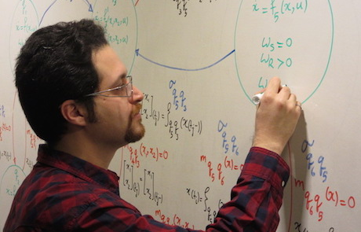
Systems and Control Group
Peter Caines & Aditya Mahajan
Systems & Control
Research interests include decentralized stochastic control, team theory, reinforcement learning, multi-armed bandits and information theory.

Slide 28
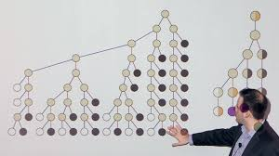
Integrated Systems for Information Processing
Warren Gross
Systems & Control
His work focuses on efficient deep learning models, hardware for machine learning, stochastic computing, hardware-aware design-space exploration for neural networks, machine learning for digital communications, and efficient decoding algorithms and hardware for error-correcting codes.

Slide 29
Derek Nowrouzezahrai CIM Director
Electrical and Computer Engineering
Director of McGill Graphics Lab
CIFAR AI Chair

Slide 30
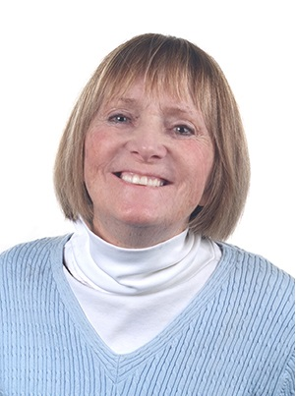
Admin Staff
Chelsea Rogers, Communications Associate
Marlene Gray, CIM Manager

Slide 31
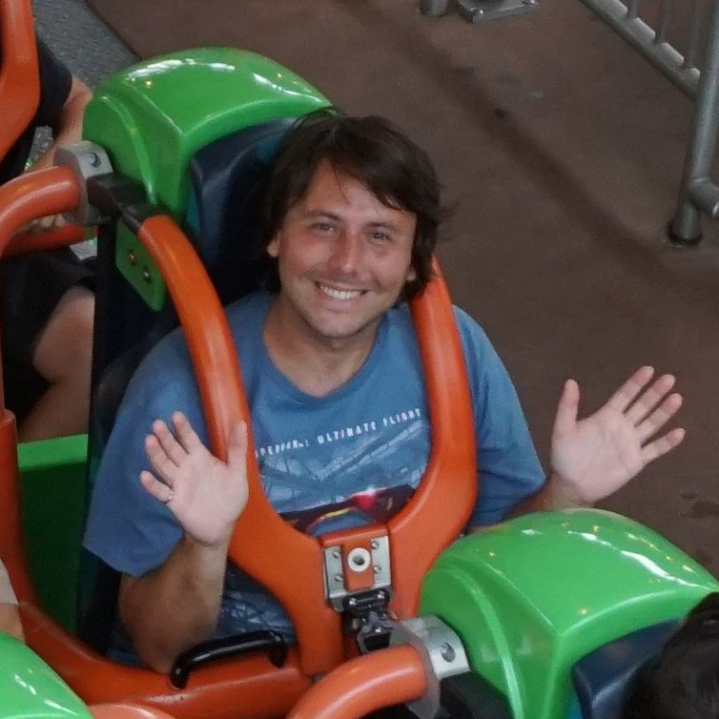
IT Staff
Olivier St-Martin Cormier, Systems Manager
Nick Wilson, Systems Administrator

Slide 32
CIM Facilities & Community
Conference Room MC 437
Meeting Room MC 409
IT services
Student events
Industrial Liaison Program

Slide 33
Resources & Contacts
Visit the CIM Wiki! https://wiki.cim.mcgill.ca/
General inquiries: support@cim.mcgill.ca
Marlene Gray: manager@cim.mcgill.ca
Chelsea Rogers: crogers@cim.mcgill.ca
Olivier St-Martin Cormier: olivier@cim.mcgill.ca
Nick Wilson: nick@cim.mcgill.ca

